Slide 1

IBM Internship / Training
PROJECT-CyberShield AI
AI-Based Cyber Threat Detection Framework IBM–NASSCOM PBEL 3.0 Virtual Internship Project Developed by: Yash Shukla(btech aiml)

Slide 2
Problem Statement
Rapid growth of phishing, malware, and malicious websites poses serious cybersecurity risks.
Traditional blacklist and signature-based detection methods cannot detect new (zero-day) attacks effectively.
Manual URL verification is slow, inefficient, and prone to errors.
An intelligent, real-time solution is required to accurately classify suspicious URLs.
CyberShield AI addresses this challenge using Machine Learning for automated URL threat detection with explainable predictions.

Slide 3
Objectives
Develop an AI-based framework to detect malicious URLs.
Classify URLs as Benign, Phishing, Malware, or Defacement.
Extract meaningful URL-based features for analysis.
Achieve high prediction accuracy using Machine Learning.
Provide real-time threat detection through a Streamlit dashboard. Improve transparency using Explainable AI (SHAP).

Slide 4

Technology Stack
Category | Technology
Programming Language | Python 3
Frontend | Streamlit
Machine Learning | Scikit-learn, XGBoost
Data Processing | Pandas, NumPy
Visualization | Plotly, Matplotlib
Explainable AI | SHAP
Model Storage | Joblib
Dataset Format | CSV / Parquet
Development Tool | VS Code

Slide 5
Dataset
Dataset Used:
Target Classes
Key Features
Malicious URLs Dataset (Kaggle)
Total Records: 641,099
Features: 43
Classes: 4
✅ Benign
🎣 Phishing
☠️ Malware
🌐 Defacement
URL Length
Domain Length
HTTPS Usage
Digit Count
Special Characters
Entropy
Suspicious Keywords
Complexity Score

Slide 6
System Architecture
Workflow
🌐 User Enters URL
↓
⚙️ Feature Extraction
(URL Length, HTTPS, Entropy, etc.)
↓
🤖 XGBoost Model
↓
🛡️ Threat Detection
(Benign / Phishing / Malware / Defacement)
↓
📊 Confidence Score
↓
🧠 Explainable AI (SHAP)
↓
💻 Streamlit Dashboard
Modules
URL Input Module
Feature Extraction Engine
ML Prediction Engine
Explainable AI (SHAP)
Threat Analytics Dashboard
Prediction History

Slide 7
Machine Learning Models
Models Used
Why XGBoost ?
Evaluation Metrics
🌳 Random Forest
🚀 XGBoost (Selected Best Model)
Higher prediction accuracy
Faster training and inference
Handles large datasets efficiently
Reduces overfitting
Better generalization performance
Accuracy
Precision
Recall
F1-Score
Confusion Matrix

Slide 8
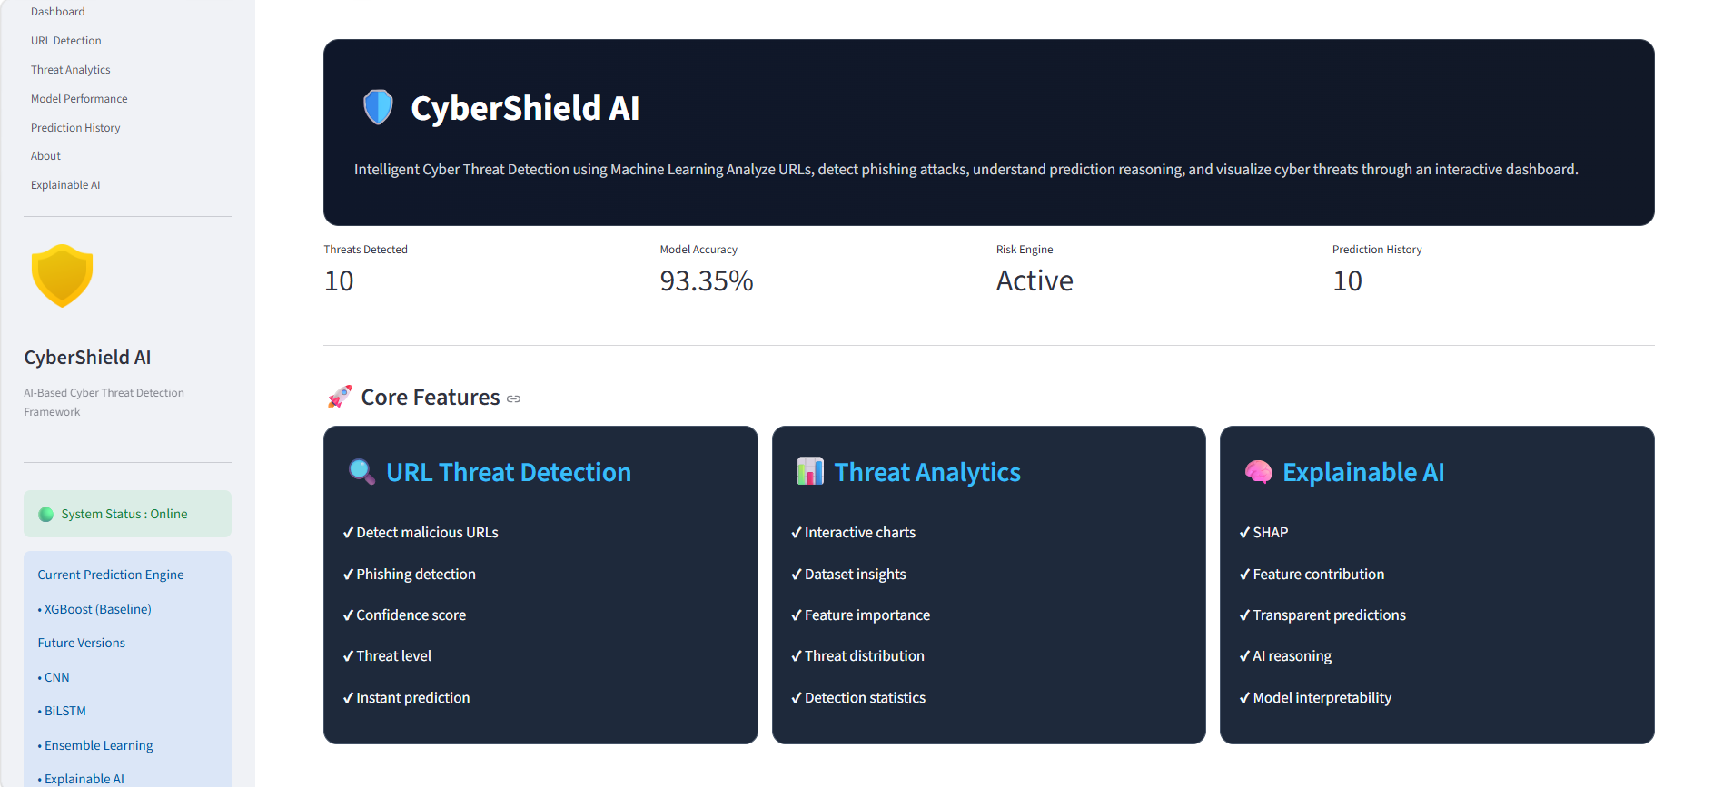
Streamlit Dashboard
Dashboard Modules
🏠 Home
🔍 URL Detection
📊 Threat Analytics
🤖 Model Performance
📜 Prediction History
🧠 Explainable AI

Slide 9
Results
Project Outcomes
✅ Successfully classified URLs into Benign, Phishing, Malware, and Defacement
✅ Real-time URL prediction through the Streamlit dashboard
✅ Confidence score displayed for every prediction
✅ Trusted domains correctly identified using domain verification
✅ Prediction history stored for future analysis
✅ Explainable AI (SHAP) integrated for transparent predictions
Key Achievements
✔ Interactive dashboard with multiple modules
✔ High prediction reliability
✔ Easy-to-use interface for cyber threat detection
✔ Scalable framework for future enhancements

Slide 10
Future Scope
Future Enhancements
🤖 Integrate Deep Learning models (CNN, LSTM, Transformer)
🌐 Develop a Browser Extension for real-time website protection
📱 Launch a Mobile Application for on-the-go threat detection
☁️ Deploy the system on Cloud Platforms (AWS, Azure, GCP)
🔄 Integrate Live Threat Intelligence Feeds for continuous updates
Expected Impact
Faster and more accurate cyber threat detection
Improved user awareness and online safety
Scalable solution for personal and enterprise cybersecurity

Slide 11
THANK YOU

